Slide 1
What is Cross Cultural Psychology?
Psych 1a
Dr Eden Thain

Slide 2
Acknowledgement of Country
We acknowledge and pay our respects to the Kaurna people, the traditional custodians whose ancestral lands we gather on. We acknowledge the deep feelings of attachment and relationship of the Kaurna people to country and we respect and value their past, present and ongoing connection to the land and cultural beliefs.

Slide 3
Structure of the Module
Lecture 1
What is Cross Cultural Psychology?
Importance of Culture
Culture, Race, Ethnicity
Lecture 2
Multiculturalism
Multiculturalism, Race, and Identity
Cultural Competence
Cultural Adaptation
Lecture 3
Measuring the similarities and differences between Cultures and their effects
Therapy and Mental Illness
Lecture 4
Indigenous Psychology
Role of Psychologist working with Indigenous Australians
Lecture 5
Indigenous Research
Indigenous Research Ethics

Slide 4
Textbook
Passer, M. W. & Smith, R. E. (2019). Psychology – The Science of Mind and Behaviour (Australian Edition 3e). McGraw-Hill: North Ryde, NSW
Chapter 18 – Indigenous and Cross-Cultural Psychology by Darren Garvey and Emily Castell
Some points will refer directly – the knowledge is examinable

Slide 5
Study Plan
Reading the Textbook and watching the Lectures
Attend/Watch the Workshop
Note, review, reflect, and revise content
Complete the assessment tasks

Slide 6

Is psychology the same all around the world?

Slide 7
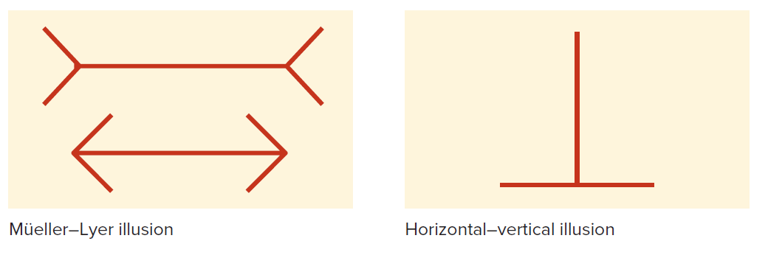
Example – Perception
Do people of different backgrounds perceive the world around them the same way?
Figure 18.14
(Passer & Smith, 2019, p. 759)

Slide 8
Example – Social Psychology
Social Loafing
“The reduction of individual effort that occurs when people work in groups compared to when they work alone.”
(APA Online Dictionary)
Found in Western individualist cultures but what about more “collectivist cultures” (Eastern Cultures)?
The effect is present but significantly lower
(Karau & Williams, 1993)
Possibly linked to higher power distance is involved
The degree to which less powerful members of a group accept the power distribution of the context
(Klehe & Anderson, 2007)

Slide 9
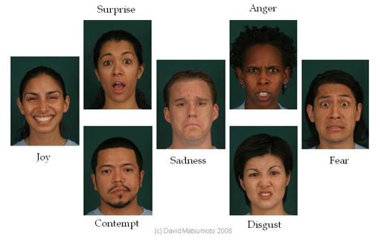
Examples – Emotion
Do different cultures display the same facial emotions?
YES
(Matsumoto & Juang, 2013, p. 215)

Slide 10
Examples – Emotion
Originally thought that they had to be learned
“Universality studies” by Ekman and Izard (1960s – 1970s) showing six universal expressions in literate and preliterate cultures
Replicated in 27 studies
Meta-analyses in 168 data sets
Note - this doesn’t mean that the same emotion is always shown at the same time
(Matsumoto & Juang, 2013, p. 215)

Slide 11
Universalism
The position that certain aspects of the human mind, human behavior, and human morality are universal and essential and are therefore to be found in all cultures and historical periods. Universalism is thus a form of essentialism and is opposed to relativism
APA Online Dictionary
Cultural and Cross Cultural Psychology want to answer what is universal and what is relative to culture?

Slide 12
What is Cross-Cultural and Cultural Psychology?
Cultural Psychology (Emic)
Cross Cultural Psychology (Etic)
An interdisciplinary extension of general psychology concerned with those psychological processes that are inherently organized by culture. It is a heterogeneous class of perspectives that focus on explaining how human psychological functions are culturally constituted through various forms of relations between people and their social contexts. As a discipline, cultural psychology relates to cultural anthropology, sociology, semiotics, language philosophy, and culture studies. APA Online Dictionary
A branch of psychology that studies similarities and variances in human behavior across different cultures and identifies the different psychological constructs and explanatory models used by these cultures. It has been influenced by anthropology and emphasizes social psychological analyses of international differences.
APA Online Dictionary
Cross-cultural psychologists compare the similarities and differences in behaviour across different societies or cultures
(Westen et al., 2017; Triandis, 2010)

Slide 13
Importance of learning Cultural and Cross Cultural Psychology
A link to other disciplines – strong history in anthropology
Nature-Nurture separations being erroneous
Links to religion, class, and subcultural life
Everyday exploration of human life and change
Methodological variation in psychology
(Cohen & Kitayama, 2018)
Growing understanding and use of Indigenous knowledges from around the world
Need to decolonise psychology and society
(Berry, 1997, p. 66)

Slide 14
What is culture? - Stop now and reflect
What is your culture?
Can you list your cultures characteristics?
Is this easy or not?
What did you include?
Rules, behaviours (practices and rituals), beliefs, fashion, social roles, what else?

Slide 15
Culture
Property of identifiable groups of people who share common understandings, rituals, social regulation, religions and place
“Shared way of life of a group of people”
(Berry et al., 2011, p. 4)
Includes rules
Sometimes explicitly but not often written down
Common for a bulk to be from implicit learning
“a system of inherited conceptions expressed in symbolic forms by means of which men [sic] communicate, perpetuate, and develop their knowledge about and attitudes toward life”
(Geertz, 1973)

Slide 16
Culture continued.
1. the distinctive customs, values, beliefs, knowledge, art, and language of a society or a community. These values and concepts are passed on from generation to generation, and they are the basis for everyday behaviors and practices.
2. the characteristic attitudes and behaviors of a particular group within society, such as a profession, social class, or age group
APA Online Dictionary

Slide 17
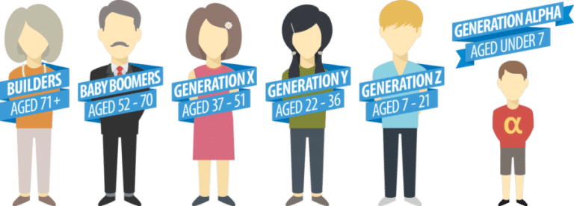
What is Cultural and what isn’t?
Art?
Fashion?
Food?
Ritual / practices?
Traditions / symbols?
Beliefs?
Holidays?
Relationships?
Old?
Constant?
New?
Evolving?
“… there is no way of escaping Alfred Lang’s (1997, p. 389) conclusion ‘‘that attempts at defining culture in a definite way are futile’’… it is quite practicable and defensible simply to use the term without seeking to define it.”
(Jahoda, 2012, p. 300)
This Photo by Unknown Author is licensed under CC BY-SA

Slide 18
Difference between Race, Nationality, and Ethnicity
Race
Heritable physical characteristics
Nationality
A person’s country of origin
Ethnicity
Cultural heritage, Common Ancestral Origin, Language, Traditions, Often based on Religion or Geography
Inc. Skin colour, facial features
E.g., Australia, Brazil, China
Exclusive concepts, not mutually exclusive for behaviour and society

Slide 19
Reflection
What things do you think you take for granted as part of your culture?
What ways could you become more aware of these?
Why may some of these be important, or even critical, for future work as a psychology professional?

Slide 20
References
American Psychological Association. (n.d). Culture. In APA dictionary of psychology. Retrieved June 2021 from https://dictionary.apa.org/culture
American Psychological Association. (n.d). Social Loafing. In APA dictionary of psychology. Retrieved June 2021 from https://dictionary.apa.org/social-loafing
American Psychological Association. (n.d). Universalism. In APA dictionary of psychology. Retrieved June 2021 from https://dictionary.apa.org/universalism
Berry. (1997). Handbook of cross-cultural psychology (2nd ed.). Allyn and Bacon.
Berry, J. W., Poortinga, Y. H., Breugelmans, S. M., Chasiotis, a., & Sam, D. L. (2011) Cross-Cultural Psychology: Research and applications (3rd ed.). Cambridge University Press.
Cohen, D., & Kitayama, S. (2018). Handbook of Cultural Psychology (2nd ed.). The Guilford Press.
Geertz, C. (1973). The interpretation of cultures : selected essays. Basic Books.
Jahoda, G. (2012). Critical reflections on some recent definitions of “culture.” Culture & Psychology, 18(3), 289–303. https://doi.org/10.1177/1354067X12446229

Slide 21
References
Karau, S. J. & Williams, K. D. (1993). Social Loafing. Journal of Personality and Social Psychology, 65(4), 681–706.
Klehe, U., & Anderson, N. (2007). The Moderating Influence of Personality and Culture on Social Loafing in Typical versus Maximum Performance Situations. International Journal of Selection and Assessment, 15(2), 250–262. https://doi.org/10.1111/j.1468-2389.2007.00385.x
Matsumoto, D., & Juang, L. (2013). Culture & Psychology (5th Edition). Wadswoth Cengage Learning.
Passer, M. W. & Smith, R. E. (2019). Psychology – The Science of Mind and Behaviour (Australian Edition 3e). McGraw-Hill: North Ryde, NSW
Triandis, H. C. (2010). A history of the study of their relationship. In S. Kitayama & D. Cohen (Eds.), Handbook of cultural psychology. Guilford Press.
Westen, D., Burton, L. and Kowalski, R. (2017). Psychology: Australian and New Zealand Edition. Wiley: Milton, Qld.

